Slide 1
Network Simulation
Craig Koorn Supervisors: Barry Irwin
Alan Herbert

Slide 2
Overview of Existing Work

Slide 3
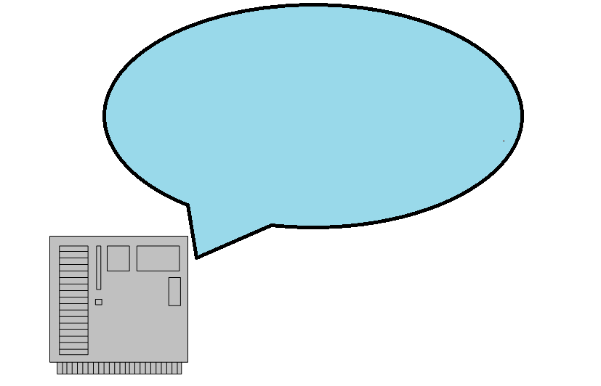
Overview of Existing Work

Slide 4
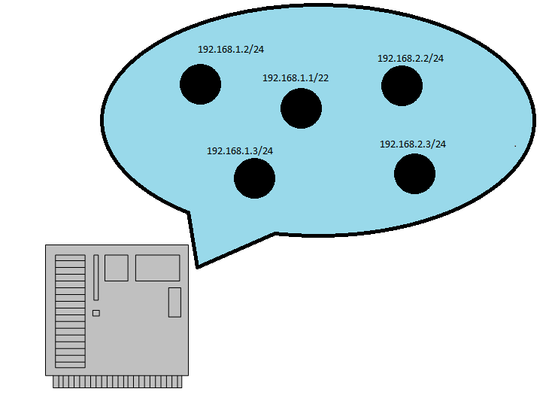
Overview of Existing Work

Slide 5
Overview of Existing Work

Slide 6
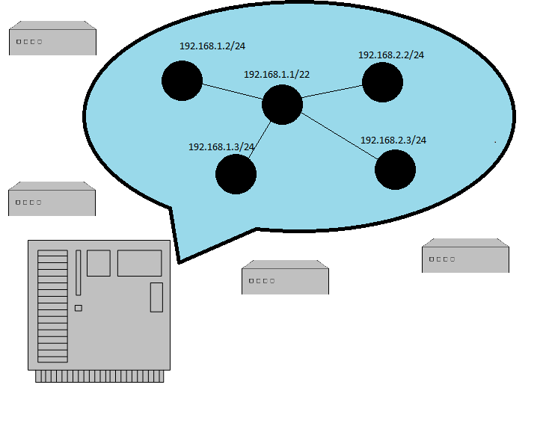
Overview of Existing Work
Notes:
the host, hosting the simulation

Slide 7
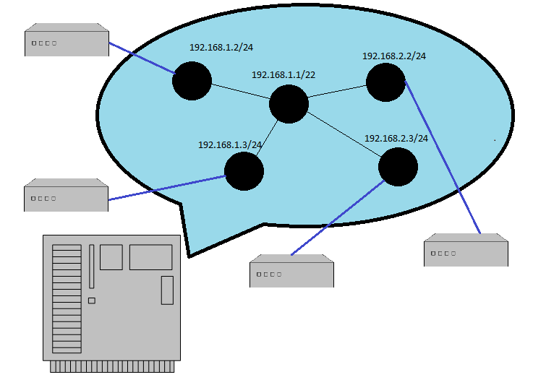
Overview of Existing Work

Slide 8
Specifics
7Gbps Throughput
Protocol Support
UDP, TCP, and ICMP
Exhibits Realistic Behaviour
Delay, packet loss, packet mangling, and network jitter.
Highly Scalable

Slide 9
My Goals
Port the System to a Modern Kernel
Develop an Internet Background Radiation Engine
Introduce Port Personalities
Improved Routing Topology
Introduce a Graphical User Interface [If time permits]

Slide 10
Port the System to a Modern Kernel
System implemented as kernel module
Uses the procfs for configuration directives
Redo module API

Slide 11
Develop an Internet Background Radiation Engine
Non-productive network traffic
Misconfigurations and malicious traffic
IBR Injection
Replay existing IBR captures
Notes:
.

Slide 12
Introduce Port Personalities
Behaviour
Classification
nmap

Slide 13
Improved Route Topology
Border Gateway Protocol (BGP)
Omit computational overhead
Reproduce topology using existing information

Slide 14
Introduce a Graphical User Interface
Enhance experience
Web interface

Slide 15
Questions?

